Slide 1


overall_1_132209786039179418 columns_5_132210801157033491
Sagility: Customer Adjacency
Phase 2 – Update, February 2026

Slide 2

New customer segment deep-dives
Medtech Commercialization
Pharma Commercialization
P&C

Slide 3
Approach: We have assessed XX elements as part of the execution roadmap
WIP
Priority SLs
Value proposition (linked to buying behaviour)
Actions to develop offering
Actions to setup GTM
Delivery talent hiring/ training
Hiring sales and solutioning talent
Senior talent
Lead gen investments (marketing)
Priority customer segments and top customers
Tech investments
Industry advisors…
At the bottom add – based on voice of customer (add logos for this vertical) and leading vendors (logos)

Slide 4
Summary: Proposed approach for Sagility to build an adjacent business in Pharma Commercialization (1/2)
INTERNAL NOTE – Answer may change basis client inputs on existing capabilities
1
Across the 4 service lines within Pharma commercialization, Sagility can prioritize Commercial S&M and Patient Engagement as the primary entry wedges and Medical Affairs as secondary entry wedge in the near term – given alignment with Sagility’s capabilities and customer openness for new vendors
Commercial S&M: Strong primary wedge given a) strong capability alignment due to high-volume, SLA-driven activities such as content production, MLR coordination, CRM administration, incentive compensation, launch readiness, analytics reporting, and b) high customer openness to new vendors; conversations with customers like Ipsen and Organon indicate willingness to test new partners
Patient Engagement: Strong primary wedge given a) increasing criticality of service line with rise of specialty & rare disease therapies, requiring structured, compliant outreach models to drive therapy initiation and persistence, b) rule-based workflows & HIPAA-compliant contact center environments that create a natural fit for scalable offshore execution partners, and c) moderate-to-high customer openness for new vendors
Medical Affairs: Selective entry potential, where credibility, TA depth, senior leadership (PharmD/PhD) are critical. Structured content production & MI governance models may serve as initial footholds, with positioning anchored in compliance rigor & risk containment; Pharmacovigilance: Remains conservative or new entrants due to high regulatory sensitivity, inspection readiness requirements & entrenched vendors
Across customer archetypes – Large Pharma, Small-to-Mid Pharma, Biotech, and CROs – Biotech and Small-to-Mid Pharma represent the most actionable segments for Sagility given greater openness to modular partners, leaner internal infrastructure, and lower reference thresholds relative to large pharma and CROs
Large pharma prefer established, best-of-breed vendors with extensive track records, while CROs have increasingly built in-house commercialization capabilities, limiting subcontracting opportunity
Biotech and small-to-mid pharma firms – often building commercial infrastructure from scratch – demonstrate a) moderate-to-high openness to new partners for Commercial S&M given lower regulatory sensitivity, emphasis on speed and pricing, lean in-house teams & urgent scaling needs; and b) moderate openness to new partners for Patient Engagement given structured activities, lower scientific ownership sensitivity
Large opportunity exists with multiple biotech and small-to-mid pharma firms (e.g., Biotech: Ipsen, Amgen; small-to-mid sized pharma: Organon, Dr. Reddy’s); US-HQ companies account for 50%+ of global biotech R&D investment and six out of every ten FDA-approved therapies
Vendor switching in Pharma Commercialization is both performance-/ risk reduction-led and cost-led (given Biotech firms are typically capital constrained). Key selection criteria centers on TA expertise, proven track record, competitive pricing, and SLA transparency/ governance maturity with service line specific nuances (e.g., innovation in offerings for Commercial S&M, breadth of offerings for Patient Engagement). Buying happens at a service-line level, with buying centers/ KDMs being fragmented
Sagility’s differentiation lies in combining cost-efficient global delivery with commercialization-specific workflow rigor, embedded with AI/ automation and advanced analytics, to create a high-transparency, execution-focused alternative to strategy-heavy incumbents that typically focus on large pharma cos. – a) position as an execution specialist, enabling faster ramp-up, lower cost-to-serve, and tighter SLA adherence in operationally intensive workflows, b) offer modular pod-based model that allows rapid capacity scaling during launch peaks without full-program overhead (typical of larger incumbents), and c) structured QA and workflow discipline can reduce compliance and audit risk in high-volume environments
Commercial S&M: Sagility offers a modular, SLA-anchored execution engine for high-volume commercial operations (content ops, MLR coordination, CRM, IC, analytics), delivering faster ramp-up, granular output transparency, and materially lower cost-to-serve than bundled, strategy-heavy incumbents – some investments required in inhouse tech and talent
Patient Engagement: Sagility provides a compliance-first, performance-managed patient outreach model that combines TA-trained agents, structured QA governance, and measurable adherence outcomes –positioning it as a scalable, cost-efficient alternative to traditional call-center or fully integrated hub vendors – some investments required in inhouse tech and talent
2
3
4

Slide 5
Summary: Proposed approach for Sagility to build an adjacent business in Pharma Commercialization (2/2)
5
Sagility already has strong existing talent to support select ops-heavy activities within Commercial S&M and Patient Engagement, but will require targeted capability enhancement to establish deeper domain credibility
Commercial S&M: Sagility has a credible operational base in analytics, CRM workflow support, and reporting, but must augment with medically literate domain SMEs, platform-certified talent (e.g., Veeva/SFDC), and structured promotional compliance training to deliver commercialization-ready execution
Patient Engagement: Sagility’s existing hub and contact center infrastructure provides a scalable foundation for structured outreach, but requires therapy-area training, compliant engagement scripting, and enhanced adverse event escalation capabilities to support specialty-focused adherence programs
Medical Affairs: Limited direct adjacency and must build credibility through senior PharmD/PhD leadership, TA-experienced medical SMEs, and robust non-promotional governance frameworks to compete effectively in scientifically sensitive engagements
Sagility’s operational tech stack (CRM familiarity, cloud infrastructure, contact center platforms, workflow-led delivery, reporting) provides a scalable backbone; closing competitiveness gaps will require a hybrid build–partner approach – developing lightweight workflow IP in-house (e.g., content ops accelerators, analytics templates) while partnering with established platforms for digital content factory, omnichannel orchestration, and AI-enabled BI to avoid heavy capex and accelerate time-to-market
Example (inhouse IP): Indegene has multiple inhouse IP such as automated content creation and approval, HCP engagement platform; Eversana has 3 niche platforms focused on reporting and benchmarking (Intellicenter) and sales analytics (ACTICS)
Example (partnerships): Indegene has 2 established partnerships with industry leaders, i.e., MS Dynamics (CRM) and Veeva (content creation); Eversana has partnerships with GoMo Health (Patient engagement platform), Symphony (access to patients claims data – now part of IQVIA)
A three-pronged phased GTM strategy is recommended for successful market entry – building sales and solutioning, credibility-led marketing and a high caliber advisor; this can be executed in a staggered manner, starting with a practice lead and senior advisor, and adding domain SMEs and hunters as traction builds
Sales and solutioning: Build a dedicated Pharma sales and domain SME talent base by hiring <in-house availability of select resources to be tested with Sagility team>
Seasoned Commercial Lead with 15-20 years of Pharma experience who can define the entry wedge, shape ROI-led offerings, and anchor senior client engagement
Domain SMEs across service lines who can translate pain points into compliant, scalable solutions
Sales hunter with established OEM relationships to drive new logo acquisition; and (d) delivery leadership and relevant talent with Pharma governance and regulatory discipline to ensure scale, high quality delivery
Marketing/ lead generation: Drive targeted lead generation via industry conferences (e.g., Fierce Pharma Week) and presence in relevant industry publications
Advisory board: Establish a senior Pharma advisory board with one former CXO to accelerate credibility and access, open doors within target accounts, help refine client pitches, and guide early account strategy
A phased, hybrid path-to-scale strategy can maximize speed and credibility – A) organic expansion into Commercial S&M and Patient Engagement, and B) acquisition-led entry into Medical Affairs
Commercial S&M and Patient Engagement: Build organically by leveraging a) existing operational capability & talent overlap, and b) moderate-to-high customer openness; supplement with targeted senior position hiring
Medical Affairs: Inorganic expansion will accelerate scientific credibility, talent / capability acquisition, regulatory track record, and referenceable client base
6
7
8

Slide 6
Services lines: The Pharma commercialization value chain has 4 elements, with Commercial and Patient Engagement showing most overlap with Sagility’s capabilities
1
WIP
Text to be refined. Harvey balls to be added under each to explain degree of overlap with Sagility’s existing capabilities
Pharma commercialization service lines
MEDICAL AFFAIRS
PHARMA-COVIGILANCE
COMMERCIAL (S&M)
PATIENT ENGAGEMENT
Define medical strategy and scientific positioning
Drive KOL¹ engagement and MSL² scientific exchange
Conduct medical research, HEOR³ and RWE⁴ analysis
Develop scientific content and manage MLR⁵ review and approval processes
Monitor, collect, and triage adverse events
Ensure case processing, reporting & global safety compliance
Conduct signal detection, aggregate reporting & risk mgmt.
Support regulatory submissions and post-marketing safety commitments
Develop brand strategy, launch planning and omnichannel campaigns
Execute field force enablement, inside sales, and CSO⁶ deployment
Deliver content ops, analytics and marketing automation
Drive commercial ops (forecasting, targeting, incentive comp, CRM)
Provide adherence programs, nurse education support and case mgmt.
Operate call centers and omnichannel patient engagement
Administer co-pay assistance, affordability and reimbursement support
Note: 1. Key Opinion Leader | 2. Medical Science Liaison | 3. Health Economics and Outcomes Research | 4. Real-world evidence | 5. Medical-Legal-Regulatory | 6. Contract Sales Organization Source: Market participant interviews, Secondary research, Bain analysis

Slide 7




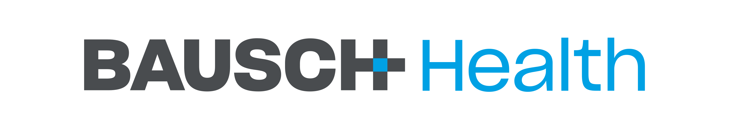







Customer archetypes: 4 key customer archetypes exist, within which Mid/Small pharma and biotech companies are most attractive for Sagility
2
Proposed priority segments for Sagility
 | Large Pharma Cos (with >$10B revenue) | Mid/ Small Pharma Cos (with <$10B revenue) | Biotech Cos (Bio-derived complex TAs) | CROs/ CDMOs (3P drug dev. partners)
Description | Global pharma cos with diversified multi-asset portfolios, integrated R&D-to-commercial infra, global presence, strong internal functional depth, mature governance & compliance | Pharma cos with focused portfolios and selective geo exposure, leaner op models, evolving internal capabilities and higher strategic reliance on partnerships to scale development & commercialization | R&D-intensive, science-led cos built around bio-derived, complex or specialty TAs (e.g., biologics, rare disease, oncology), typically asset-concentrated, capital-efficient and operating with limited legacy infra | Development and manufacturing partners supporting pharma and biotech firms across clinical, regulatory, and production workflows, operating asset-light or infra-led models with program-driven revenue streams
Select players
Sagility’s alignment with customer buying preferences | Low-to-moderate alignment driven by: Retain regulatory accountability & core scientific decisioning in-house; extensive GCC footprint for standardized back-office & analytics Limited o/s for high-risk, regulatory-sensitive or IP heavy functions (e.g., PV); high o/s for execution-heavy, process-driven workflows, driven by scale & cost efficiency Pref. for a few T1 vendors (IQVIA, Syneos, Accenture, Parexel) with E2E delivery, multi-TA breadth & ability to manage cross-market programs; selectively engage best-of-breed niche vendors for differentiated capabilities (digital, analytics, AI) Strong emphasis on referenceability, therapeutic depth, scalable footprint and strong governance controls | High alignment driven by: Leaner internal functional depth across MA, PV and commercial ops with limited or emerging GCC footprint (e.g., Organon has ops in India for select pockets of ops work); retain strategic oversight & regulatory accountability High o/s for non-core but operationally intensive workflows; moderate for regulatory-heavy processes, with increasing openness to bundled or E2E o/s Prioritize focused set of credible, HC-specialist vendors with flexible delivery models; less constrained by T1 vendor lock-in and more focused on execution depth and flexibility KPCs incl. proven execution across comparable portfolio sizes, therapeutic familiarity, cost efficiency and ability to scale; referenceability & delivery reliability preferred over brand equity | High alignment driven by: Minimal internal infra with limited meaningful GCC footprint; scientific ownership and benefit-risk decisioning retained in-house O/s operational, safety & engagement workflows – high across S&M, patient engagement functions; moderate-high for the others; willing to outsource E2E models where partners can provide compliance, scalability, and cost visibility Prefer HC-specialist partners capable of rapid ramp-up across complex TAs; less constrained by T1 vendor lock-in and more focused on execution depth and flexibility KPCs incl. speed-to-launch, regulatory compliance, TA expertise in complex or bio-derived modalities, scalable capacity and ability to operate under capital and timeline constraints; TA-specific referenceability valued over brand equity | Low-to-moderate alignment driven by: Limited standalone ownership of value chain processes (MA, PV, S&M or patient eng.); strong and scaled inhouse teams managing commercialization ops work O/s structurally limited given they have scaled commercialization capabilities inhouse; O/s is transactional and scope-bound, typically for specific technical gaps vs E2E commercialization workflows Engage subcontractors selectively only for narrow capability gaps/ surge capacity KPCs incl. process reliability, regulatory compliance, seamless integration into sponsor systems & cost efficiency; emphasis on operational fit vs. vendor scale
Source: Market participant interviews, Bain analysis, Secondary Research

Slide 8
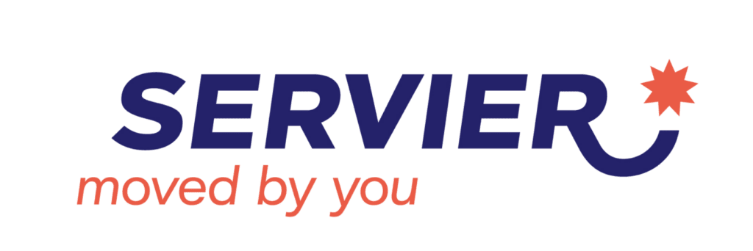






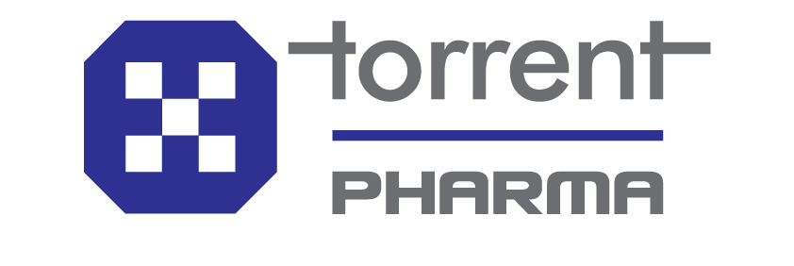



2
Customer archetypes: Several large companies exist across Mid/small pharma and Biotech segments for Sagility to target
WIP – Trying to add more details by customer (geo coverage, small blurb on products, etc.)
Non-Exhaustive
Mid/ Small Pharma companies
Biotech companies
~$7.2B
~$6.4B
~$9.7B
~$7.8B
~$6.4B
~$4.4B
~$7.7B
~$4.9B
~$3.9B
~$3.4B
~$4.3B
~$3.7B
~$2.8B
~$2.6B
~$1B
~$3B
~$2.3B
Note: 1) Numbers indicate FY24 consolidated revenue numbers | Source: Market participant interviews, Bain analysis, Secondary Research

Slide 9
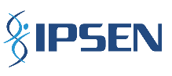
Buying Behavior – Ipsen (1/2): Reputational, regulatory, and compliance-critical tasks retained in-house; scalable execution, analytics, and documentation outsourced
3
BIOTECH CO.
Ipsen is a small-to-mid biopharma co. with US presence (~$1.5B US revenue) and is organized across 3 TAs – Oncology, Rare Disease, and Neuroscience. Each TA manages its own portfolio of assets, while centralized procurement controls vendor onboarding, RFPs and MSA governance across commercialization functions
Medical Affairs
Pharmacovigilance
Commercial (S&M)
Patient Engagement
Outsourcing Philosophy | In-house: Core scientific leadership and asset accountability (incl. MSL¹ deployment and KOL/ MSL engagement, therapeutic-level medical strategy, final scientific sign-off on materials & oversight of medical narratives and evidence positioning), given direct reputational and compliance risk ownership Outsourced: Concentrated in structured operational and analytics support layers, incl. MSL¹ enablement ops (KOL documentation, briefing materials), RWE/ HEOR² analytics support, medical content drafting, MI handling , MLR³ workflow coordination (routing, version control, reconciliation, approval/ audit tracking) | In-house: Strategic safety ownership and regulatory accountability retained, incl. medical safety oversight, final FDA reporting responsibility, safety signal interpretation, and governance over protocol updates, given high compliance sensitivity & regulatory exposure Outsourced: Concentrated in structured safety ops and case-processing workflows, incl. ICSR⁴ intake and triage, structured data entry into safety databases, MedDRA and WHO-DD coding, narrative drafting under sponsor-defined protocols, independent QC review, literature screening, case identification and ops support for expedited FDA submissions & aggregate safety reports, where scalable execution & documented governance are reqd. | In-house: Core brand strategy & commercial accountability (incl. TA- level brand positioning, launch planning, pricing direction, messaging approval and final campaign sign-off), given direct revenue impact and executive visibility Outsourced: Concentrated in analytics, promotional asset production and MLR governance incl. proprietary prescription and physician-level targeting analytics, campaign asset creation and lifecycle mgmt. and promotional MLR coordination covering claim annotation, approval tracking & expiry mgmt., where specialized analytics and scalable execution capability are required | In-house: Program governance & compliance, incl. copay program design, affordability framework decisions, patient communication guardrails, escalation policies, compliance accountability, given direct patient impact & regulatory sensitivity Outsourced: O/s concentrated in operational delivery and financial flow execution, incl. copay card processing, pharmacy/ PBM integration, structured adherence outreach, call center support for non-medical patient inquiries and audit-traceable case documentation & follow-up coordination, where scalable manpower and structured workflow mgmt. are required
Buying Center and process | Buying center: Each TA is led by a Medical Head; MA team drives scope definition and vendor evaluation; procurement runs the RFP and enforces MSA discipline, with Legal & Compliance engaged for inputs during evaluation KDM: Tiered approval – projects worth <$500M approved by asset specific Medical Manager within TA’s MA team; mid-sized programs require TA Medical Head sign-off with CMO visibility; larger strategic initiatives escalate to US President (heads the US company, with CMO reporting into him/ her; CMO leads all the TAs) | Buying center: Pharmacovigilance sits within Medical Affairs (MA) teams; buying center same as TA KDM: Same as Medical Affairs | Buying center: Each TA has Commercial Team, led by TA Comm. Director (reports to President) that defines scope & evaluates vendors; Proc. runs RFP & validates cost constructs; Medical & Legal engaged where compliance review is required under commercial-medical firewall KDM: Tiered approval – projects worth <$500M approved by VPs within commercial teams of respective TAs (VPs head activities within Comm. Team and report to the Director); mid-sized programs require sign-off from TA Comm. Director; larger initiatives escalate to President | Buying center: Patient engagement sits under Medical Affairs due to high compliance and reputational sensitivity; relevant TA Medical Head leads vendor evaluation; procurement runs structured RFP with Legal Counsel participation given patient-facing regulatory exposure KDM: Tiered approval – projects worth <$2M approved by TA Medical Head and CMO; larger spend initiatives escalate to the US President; given patient-facing and compliance-sensitive nature of these programs
Direct vs. Indirect sales | Direct engagement model – vendors are selected and contracted through centralized procurement-led RFPs, with evaluation and decision-making driven at the TA level (Medical or Commercial, depending on service line), without use of channel intermediaries
Notes: 1. Medical Service Liaison, 2. Real World Evidence/ Health Economics and Outcomes Research, 3. Medical-Legal-Regulatory | Source: Market participant interviews, Bain analysis

Slide 10
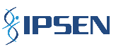
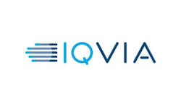
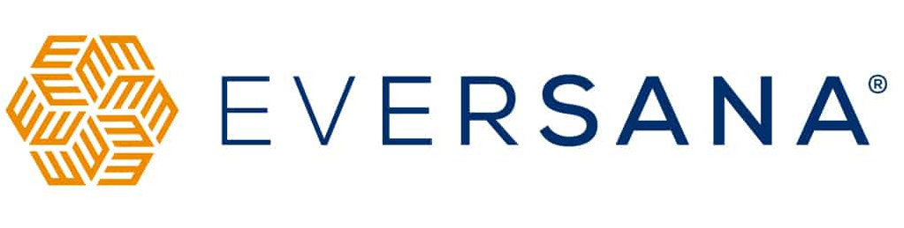
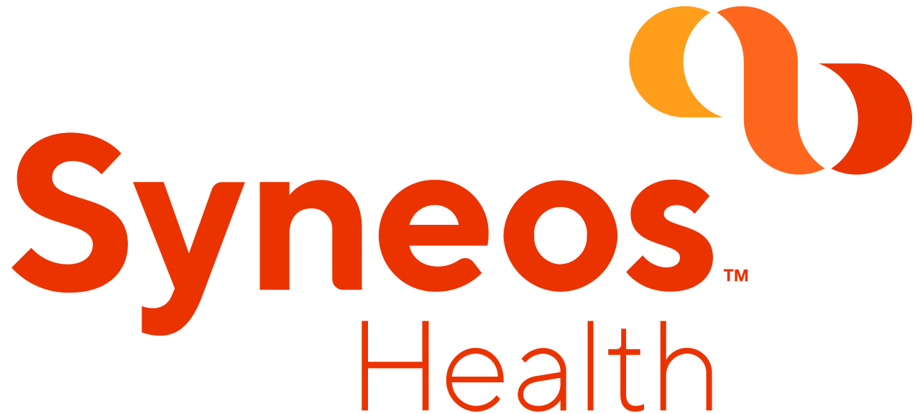







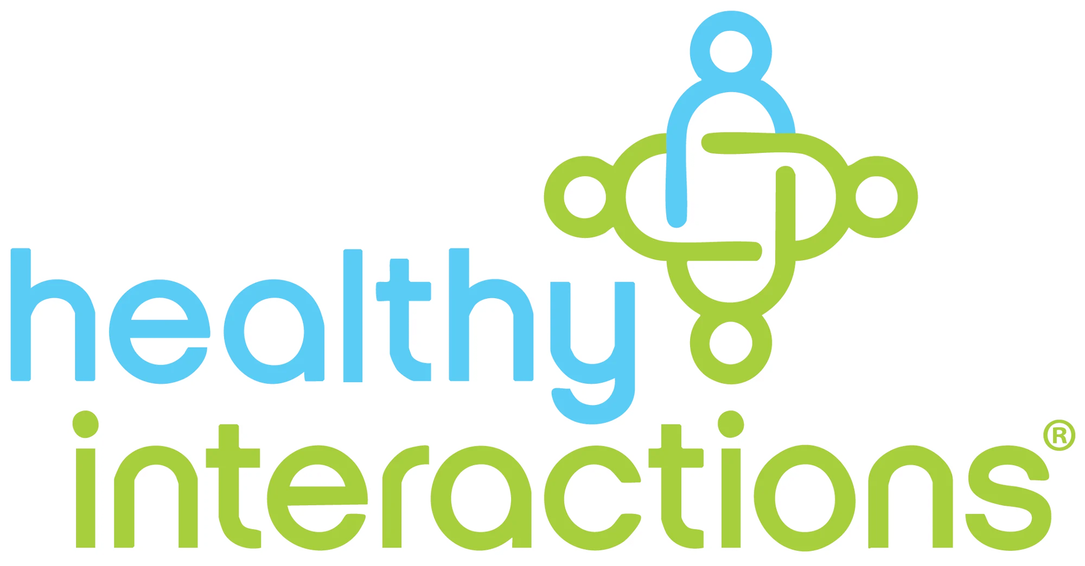

Buying Behavior – Ipsen (2/2): Moderate-to-high willingness for new vendors in commercial (S&M) and patient engagement
3
BIOTECH CO.
High willingness
Moderate willingness
Low willingness
Medical Affairs
Pharmacovigilance
Commercial (S&M)
Patient Engagement
KPCs | Expertise in relevant TA: Deep knowledge of focus TAs to enable content heavy activities (e.g., publications), KOL network (differentiator given vendors usually work on ops support only) Strong track record: Proven experience supporting MA in regulated biotech environments with credible peer references & familiarity with internal/ external MLR review Pricing: Flexibility for amendments given launches often deviate from initial timelines Delivery team relationship: 1:1 relationships with vendor teams and preference for vendors that showcase exact team members (and qualifications) upfront | Inspection readiness and SOP maturity: Proven ability to execute FDA safety submissions and support in regulatory inspections with mature SOPs in place Strong track record: Established biopharma track record with strong peer validation, minimizing risk of “first-time” vendor experimentation ICSR quality & coding accuracy: Demonstrated consistency in case intake, MedDRA/ WHO Drug coding governance, and duplicate detection with low error rates under audit review | Speed: Ability to execute quickly on task-heavy processes such as CRM setup, dashboards, and incentive comp plans (ideally within ~10 weeks) Reporting capabilities: Clear tracking of NRX, territory performance, provider targeting, patient reach, and launch ramp velocity with executive-ready reporting and analytics Pricing: Billing rates considered to be key metric, esp. for content creation and execution Strong track record: In delivering pharma campaigns within regulated environments Innovation in offerings: Leveraging AI/ GenAI to automate content production, driving effective marketing and slashing TATs | Pricing: Transparent, competitive pricing aligned with program value & scalability – highly relevant for biopharma given typically cash constrained Expertise in relevant TA: Deep knowledge of focus TAs to optimize patient engagement and access workflows Strong track record: Strong experience with demonstrated results in the past – across areas such as therapy acceleration (reducing time from prescription to therapy), co-pay/ financial support programs, & other initiatives Breadth of offerings: Ability to deliver E2E patient services – highly relevant for given cos prefer single vendor vs best of breed
Openness to new vendors | Low-moderate openness to test new vendors in low-risk, production heavy layers (e.g., MI intake, publication formatting, MLR workflow coordination) given teams are lean and lack scaled infra; however, willingness moderated as a) scientific credibility risk is brand defining, and b) there is a high scrutiny bar on TA depth and credentials (PhD/ PharmD) | Low openness as errors are company-threatening (esp. for firms with single/ limited assets) given a) high regulatory and FDA reporting sensitivity where inspection-readiness is the gating factor, thus favoring mature PV firms and restricting willingness to experiment, and b) stable incumbent performance with minimal dissatisfaction | High willingness given a) lower regulatory sensitivity vs MA and PV, b) emphasis on speed and pricing efficiency, and c) lean inhouse teams with urgent scaling needs | High-moderate openness, given a) operationally structured and rules based, and b) lower scientific ownership sensitivity, offset by strong reliance on peer-referenced/ credible and experienced vendors given compliance-sensitive patient-facing function
Illustrative vendor set
MI ops & medical analytics support
Advisory board logistics & exec. support
Sales analytics and targeting data enablement
Commercial ops & targeting enablement
Co-pay infrastructure & eligibility enablement
Co-pay program admin & adjudication
Pharma-covigilance ops & AE workflow support
Intake infra & call mgmt. support
Legal and compliance review support
KOL mapping & MSL analytics
Contract MSL capacity support
MLR & compliance support
Claims-based RWE analytics
Rep-facing material development
MLR legal & compliance review
Call mgmt. support
Promotional materials development
Source: Market participant interviews, Bain analysis

Slide 11

Potential value prop - Ipsen (1/3): Scope to win by leveraging AI/ automation, reducing turnaround times, specialized expertise, and flex staffing model
4
BIOTECH CO.
Service line | Current vendor landscape | Primary drivers of dissatisfaction | Triggers for switching vendors (Potential entry wedge for new vendors) | Potential scope expansion (Emerging areas with potential o/s)
Medical Affairs | IQVIA: MI ops & medical content/ comms. support incl. scientific materials creation & physician-level claims and analytics to prioritize & select KOLs for medical advisory boards Syneos Health & EVERSANA: KOL engagement support (E2E logistics & execution for medical advisory boards; Syneos for oncology, EVERSANA for others) ZS Associates: KOL mapping & field medical enablement analytics (incl. physician segmentation/ targeting outputs) Komodo Health: RWE/ claims-data enablement for MA analytics (claims-based data that support KOL mapping, insight generation) ProPharma: MSL enablement via contract field-medical resourcing (incl. provision of contract MSL capacity to support MSL coverage/ execution where internal teams remain accountable) Ropes & Gray (external counsel): Medical-legal review support aligned to MA approval needs (incl. legal/ compliance review of externally facing medical materials/ tools that require high scrutiny) | IQVIA: Slow iteration cycles on analytics, lack of visible cost dec. despite AI workflows and high cost vs. perceived efficiency gains ZS Associates: Slow data iterations leading to delayed decision cycles; rigid delivery model Selective SoW re-allocation from IQVIA and ZS to Komodo, given faster turnaround & better access to datasets ProPharma: Quality of contract MSL deployment varied by individual, with occasional gaps in depth of therapeutic expertise across field medical resources | Low implementation speed: Inability to stand up compliant MLR workflows and dashboards within timelines, coupled with prolonged review cycles, excessive iterations that delay asset approvals- impacting launch agility (even 20-30% time reduction is materially valued) Lack of executive reporting tools: Lack of structured insight capture, executive-ready dashboards, and cross-functional reporting; leadership demands clear “insight-to-action” performance transparency Operational instability: Inability to support lean teams facing scale pressure Insufficient scientific credibility in execution: Gaps in medical oversight, regulatory fluency, or pharma-specific governance - esp. when delivery depth doesn’t match RFP-stage positioning | AI-driven medical content creation/ analytics: AI/ GenAI to enhance medical content creation & RWE/ HEOR analytics Differentiated capability-led entry: Superior physician-level data granularity or materially faster analytical turnaround - as seen in Komodo’s incremental SoW expansion driven by prescription-level data access & faster refresh cycles Pockets of strategic work on back of strong domain expertise: Opportunity to externalize KOL strategy, evidence planning, scientific narrative development (with a narrow scope – e.g., for one asset with significant inhouse involvement) – today largely internal or fragmented, to specialized MA partners with deep expertise in focus domain/ TA
Pharmaco-vigilance | Syneos Health: Ops support, incl. guiding AE protocol setup and supporting AE intake workflows TELUS (Canada): PV intake infra provider, setting up and running calls (call routing, recording for compliance & backend call-center IT systems) Ropes & Gray (Legal Counsel): Pharmacovigilance legal and compliance support, constructing and reviewing patient-facing safety scripts, intake language to ensure FDA aligned comm. standards | No major dissatisfaction cited with the current vendors- except some minor setup friction during initial implementation | Case Processing Delays: Persistent ICSR¹ intake backlogs driven by manual-heavy workflows, lack of automation (e.g., NLP/OCR, auto-triage, duplicate detection), increasing compliance risk & cost burden Inspection Readiness Gaps: Audit trail gaps and inconsistent doc. due to weak workflow controls, reporting infra, creating regulatory vulnerability Data Integrity Risks: Inaccurate coding, narrative errors, poor database governance undermine signal reliability and regulatory credibility Lack of Medical Oversight: Misalignment between advertised MD/ PharmD governance and day-to-day medical signal ownership | Limited expansion appetite; scope increases only where operational efficiency improves without elevating compliance risk Automation-led intake outsourcing: Work packages that embed automation (e.g., NLP-enabled intake, auto-triage, duplicate detection etc.) into existing AE workflows - delivering FTE savings Surge-driven scope expansion: Increase in o/s during launch spikes and call volume volatility - shifting incremental intake and case processing volumes to vendors rather than scaling fixed internal headcount
Potential value proposition: Establish an integrated Medical Affairs intelligence and execution capability that embeds AI-driven content creation, fast turnaround times, and specialized scientific execution to enhance physician-level insight depth
Potential value proposition: Develop a scalable, surge-ready pharmacovigilance platform that combines automated intake, compliant case processing, and flexible capacity deployment to absorb volume volatility without elevating compliance risk
Source: Market participant interviews, Bain analysis

Slide 12
Customer case study- Ipsen (2/3): Potential to differentiate by offering digital/ AI capabilities, coupled with access to comprehensive datasets
4
BIOTECH CO.
Service line | Current vendor landscape | Primary drivers of dissatisfaction | Triggers for switching vendors (Potential entry wedge for new vendors) | Potential scope expansion (Emerging areas with potential o/s)
Commercial (S&M) | IQVIA: Sales performance analytics and reporting support, providing national claims and prescription datasets used for HCP targeting and field activity measurement Komodo Health: Additional proprietary, Rx-level data (via partnerships with Texas Oncology, etc.) to fill gaps in IQVIA coverage & improve physician-level targeting accuracy ZS Associates: Commercial ops enablement, converting IQVIA/Komodo data into HCP target lists, territory alignments, call plans and rep effectiveness tracking Ogilvy: Develops and iterates rep-facing branded materials (detail aids, campaign assets for the field team) Health Interactions & EVERSANA: Patient-facing promo materials & refresh of education materials (Rare-disease patients – Health Interactions; Others – EVERSANA) Ropes & Gray: MLR-aligned legal review - compliance oversight for promotional and patient-facing materials | IQVIA: Non-comprehensive physician-level data coverage in certain therapeutic pockets, requiring supplemental data sources Komodo: Partial clinic participation & provider opt-outs create data gaps in some geos/ systems, limiting physician-level granularity, needing cross-validation across sources Ogilvy: Repeated late-stage accuracy lapses in commercial materials (e.g., disease name misspellings discovered in final legal review), causing reprints and launch delays despite extended review cycles EVERSANA: Creative misalignment with target patient in campaigns (e.g., PBC¹ materials featuring visibly elderly patients despite core patient population being middle-aged women ~50s), signaling limited therapeutic specificity | Slow Launch: Inability to implement CRM workflows, incentive structures, dashboards within 8-12 weeks; delayed launch readiness Revenue Visibility Gaps: Failure to link field activity to NRX², territory performance, and launch ramp velocity; absence of executive-ready dashboards CRM under-optimization: CRM implemented but not performance-driven – suboptimal workflow logic, low adoption, weak reporting, and no clear revenue impact beyond basic configuration Incentive & Territory Misalignment: Lack of clear incentive compensation governance or fair territory alignment, creating field frustration and productivity leakage | Virtual Sales Engagement Infra: Compliant virtual call platforms for reps (beyond standard Zoom), incl. secure video tooling aligned to institutional firewall requirements AI-Driven Optimization (e.g. Predictive activity models to guide rep prioritization; “next best action” derived from what has historically worked, adjusted for data confidence & quality; Requires perf. analysis & forecasting to instruct rep behavior in real time) Data partnerships and integrations/ inter-operability: Use of state-specific or clinic-level data partnerships (e.g., ingestion of real-world data aggregates from Texas Oncology, Florida Cancer) to address blind spots in national datasets; Overlay multiple proprietary sources to improve physician-level accuracy and inform micro-market decision-making
Potential value proposition: Establish a digitally enabled commercial activation platform that embeds compliant virtual engagement infrastructure, AI-driven next-best-action models, and real-time performance steering to enhance rep effectiveness and launch precision
Note: 1. Primary Biliary Cholangitis | 2. New-to-Brand Prescriptions | Source: Market participant interviews, Bain analysis

Slide 13
Potential value prop - Ipsen (3/3): Differentiation potential by offering advanced predictive capabilities and access to multi-source datasets
4
BIOTECH CO.
Service Line | Current vendor landscape | Primary drivers of dissatisfaction | Triggers for switching vendors (potential entry wedge for new vendors) | Potential scope expansion (Emerging areas with potential o/s)
Patient Engagement | TELUS (Canada): Call center infrastructure enabling patient inquiry handling, incl. telephony routing, call recording and backend systems supporting patient-facing hub workflow McKesson: Co-pay program infrastructure support, integrating eligibility verification and back-end claims/ distribution workflows within patient support programs AmerisourceBergen (Cencora): Co-pay card program administration, conducting eligibility checks, insurer claim adjudication and payment routing at point of prescription use | TELUS: Launch-phase stabilization challenges, including early coordination gaps and slower-than-expected ramp-up during initial hub activation, leading to friction before steady-state ops were achieved McKesson/ AmerisourceBergen: Limited patient-centric adoption support during copay model transition, compounded by Ipsen’s lower prioritization relative to larger pharma client- reducing proactive engagement in driving patient uptake of card-based program Slower-than-desired turnaround times driven by shared-resource staffing models; unlike large pharma companies with dedicated teams, Ipsen operates as one of multiple clients, resulting in reduced responsiveness | Delays in Therapy Initiation: Persistent lag from script to therapy start – driven by weak benefits verification, slow prior auth turnaround, or denial mgmt. gaps; impacting launch speed and revenue realization Drop-Off & Abandonment Risk: Inability to proactively identify and reduce patient drop-off through case prioritization, predictive modeling, or structured follow-up workflows Reimbursement Expertise Gaps: Weak payer intelligence, low prior auth success rates, poor appeal conversion or limited buy-and-bill fluency (particularly critical in specialty & rare disease) leads to switching Limited Executive Visibility: Absence of real-time case tracking, therapy dashboards, and clear reporting on denial reasons, abandonment rates, and payer friction Launch Readiness Weakness: Slow hub setup, unclear SOPs, or inability to operationalize compliant patient support infra under compressed biotech timelines | Selective expansion opportunities focused on: Integrated Data Intelligence: Capability to aggregate multi-source data for therapy-start insights and denial analytics Predictive risk-Based Case Management: Deploy predictive prioritization models that proactively flag high drop-off risk patients, transitioning from reactive case handling to outcome-driven orchestration
Potential value proposition: Design an integrated engagement intelligence and orchestration hub that aggregates multi-source therapy insights, embeds predictive risk-based case prioritization, to reduce drop-off, denial friction, and time-to-therapy
Source: Market participant interviews, Bain analysis

Slide 14
<one more customer case study to be added>

Slide 15


GTM strategy: GTM roadmap for effective Pharma launch should encompass 2 dimensions – defining the right marketing strategy and optimum team & sales motion
7
A
Market Activation and Marketing
B
GTM Team and Sales Motion
Build awareness and credibility with Pharma customers through targeted positioning, thought leadership, conference participation, and ecosystem partnerships
Establish a dedicated vertical-led sales engine combining industry leadership, domain expertise, and focused hunter-driven account acquisition

Slide 16




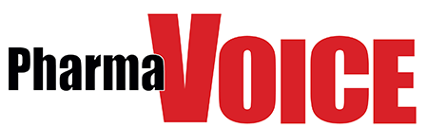
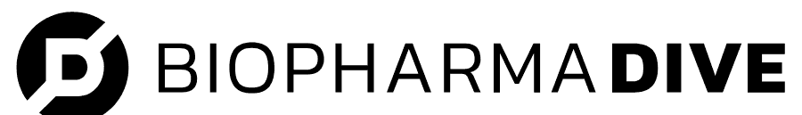





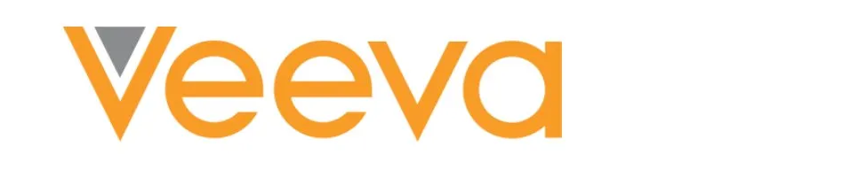





Marketing: Sagility should invest in establishing credibility/ lead generation using conferences, media publications etc. as it enters Pharma commercialization space
7A
Indegene typically participates in 30+ pharma conferences annually
Conferences
Media Publications
Implications for Sagility
Pharma USA | Cross‐functional pharma commercialization summit, spanning commercial strategy, launch excellence, market access & omnichannel engagement Features 1.5K+ attendees, key participants incl. all top-50 pharma cos. (e.g., Eli Lilly, Novartis, Amgen), and key vendors (e.g., ZS, Syneos)
 | Week-long event uniting pharma commercial, marketing, medical affairs and communication leaders to drive strategy discussions Features 3K+ attendees, key participants incl. large pharma cos. (e.g., Roche, GSK, Novartis, J&J), Syneos Health, IQVIA etc.
Commercial Summit | Premier industry forum advancing digital transf., CRM innovation & data-driven commercial execution Features 1.7K+ attendees, key participants incl. large pharma cos. (e.g., Bayer, Genmark, GSK) and ecosystem partners incl. Accenture, Indegene, Eversana, ZS, etc.
Americas Annual Meetings (Medical Affairs) | Medical Affairs forum spanning discussions on regulatory changes, new healthcare communication strategies & latest technological advances Attendees from top Biotech, Pharma, MedTech cos. & ops vendors (Parexel, Eversana, IQVIA, Indegene) alongside patient groups and academia
World Drug Safety Congress (Pharma-covigilance) | Pharmacovigilance & drug safety meeting covering post-market safety, regulatory frameworks, and innovation; important for safety/ compliance functions Features 2K+ attendees incl. IQVIA, Syneos Health, TCS, Parexel, etc.
Magazines and Newsletters | Analyst Publications
Sponsored articles, banner ads, newsletter placements, paid thought-leadership features, media sponsorships, conference-linked advertorials, etc. | Contracted research (co-branded studies), analyst contracts & briefings, reprint/ licensing rights, PR retainer & newswire, co-author proprietary research
Structured marketing engine: Anchored in 4-5 flagship conferences via speaking slots, roundtables and pre-scheduled executive meetings to gain direct access to OEM KDMs, improve RFP visibility and perform targeted ABM¹ for priority buyers
Build sustained share-of-voice in pharma commercial ecosystems: Maintain a consistent cadence of feature stories, POVs & analyst-aligned narratives in targeted outlets (e.g., PM360, Fierce Pharma, MM+M), positioning Sagility around AI-led commercialization, cost transf. & patient support innovation ahead of buying cycles
Move beyond generic HC positioning: Consistently communicate a clear wedge (e.g., tech-enabled patient services, GenAI-led engagement ops) to reinforce relevance within pharma commercial org. and differentiate from horizontal IT/ BPO peers
1
Cross-functional Pharma events
2
Peer Analogs
 | Active in analyst briefings (Gartner, Everest), frequent speaker at major pharma forums (Veeva Summit, Reuters Pharma); proprietary research (New Science)
 | Strong analyst visibility (Everest PEAK Matrix, industry rankings), sponsors major commercial conferences, publishes widely cited IQVIA Institute reports
 | Frequent speaker at commercialization events (e.g., Reuters Pharma, Veeva Summit), ranked in Everest PEAK Matrix (Commercial life sciences AI leader)
 | Active sponsor at pharma events (e.g., Veeva summit), hosts proprietary industry forums (Indegene Digital Summit), strong LinkedIn thought leadership
Focused Pharma events
3
Note: 1. Account-based marketing | Source: Market participant interviews, Secondary research, Bain analysis

Slide 17
GTM Team and Sales Enablement: Pharma commercialization will require dedicated GTM team including vertical leadership, domain SMEs, hunters and senior advisor(s)
7B
Illustrative structure
Role | Target profile
Own pharma commercialization entry strategy, defining and sequencing Sagility’s execution wedge (e.g., CRM ops, content factory, PV support), aligning with brand narrative Build & anchor senior relationships with VP/SVP Commercial/Sales Ops in mid-size pharma & biotech, leading complex, long-cycle (12-18 months) pursuits Govern pipeline, qualification rigor, and deal shaping with delivery and hunters | Experience: 15-20 yrs. in US pharma commercialization; led Commercial/Sales Ops P&L, CRM programs, measurable outcomes & enterprise pursuits with VP/SVP relationships Example Archetype: VP/ Director of Commercial Ops/ Solutions either at competitors (e.g., Indegene, IQVIA) or at mid-size pharma/ biotech firms
Shape solution offerings, ensuring operational and regulatory credibility Lead client solutioning, turning pain points into workflows, delivery models, and ROI-backed proposals; provide depth in commercial ops workflows (call planning, CRM hygiene, incentive governance, launch readiness, KPI reporting, etc.) Design compliant frameworks, incl. processes, escalation paths, quality controls, oversight | Experience: 10-15 years in pharma commercial ops with strong credentials; owned CRM transformations, territory design, incentive governance, call planning, launch programs, and analytics Example archetype: Director of Sales Ops at mid-size pharma/ biotech; or Solution Lead from ecosystem partners (e.g., IQVIA, Veeva, etc.) with PharmD/ PhD qualifications
Drive new logo acquisition aligned to Sagility’s wedge, targeting Commercial/Sales Ops leaders in growth-stage pharma and specialty biotech Own pursuit execution, qualifying opp., mapping buying centers, coordinating proposals, and advancing deals to closure with Commercial Lead | Experience: 8-12 years in pharma services/commercialization sales; experience selling CRM, analytics, or ops solutions with relevant deal cycle exposure Example Archetype: BD Manager/Account Executive in pharma-focused services or transformation firm
Accelerate access to senior buying centers through established CXO-level relationships across MedTech OEMs Refine sales narratives and positioning ensuring alignment with C-suite priorities (ROI, growth) | Experience: 25-30 years in Pharma, leading functions across scaled pharma players Example archetype: Former CXO (e.g., COO, Chief Commercial Officer) with deep industry networks
Commercial Lead
Domain SME
Hunter
Advisor
Select sample profiles for Advisors
Name | Relevant experience | Yrs. served (Exit)
Marv Richardson | Former CIO, HCSC | 6+ years (2022)
Chris C. Price | Former COO, WellCare Health Plans (Centene) | 14+ years (2023)
Diana McKenzie | Board member, Vertex (Former CIO, Amgen) | 5+ years (Present)
TBU
Hiring can be sequenced – begin with Commercial Lead and domain SME in the short-term to co-sell and validate the wedge, add dedicated hunters as pipeline scales in the medium-term, and institutionalize delivery leadership once anchor accounts are secured longer-term
Source: Research, market inputs, Bain analysis

Slide 18
Delivery Talent by SL: Strong domain and regulatory expertise is essential, with Sr. Pharma leadership, AI-trained talent, and TA expertise providing differentiation (1/4)
5
Sree/ Karthik to help identify Sagility’s existing capabilities
Service Line | Key activities | Delivery model | Essentials/ table stakes | Differentiators/ opportunities to delight
Medical Affairs | KOL / MSL Enablement: Operational support for MSLs (documentation, briefing materials, insight capture) Medical Research & RWE¹ Analysis: Literature review, evidence synthesis, and RWE/ HEOR² analytics (claims/ EHR analyses, structured outputs) under sponsor oversight Medical Content Creation: Non-promotional materials (manuscripts, abstracts, posters, FAQs, summaries, training, congress materials) aligned to sponsor narrative Medical Content Approval (MLR³) & MI Support: Medical Information drafting and MLR workflow coordination: routing, version control, reconciliation, approval tracking, audit documentation | Onshore: Sponsor interface, KOL/MSL support, therapeutic interpretation, strategic content review, RWE/ HEOR insights, compliance, and scientific sign-off Offshore: SOP-driven execution incl. publication/ congress asset support, literature reviews, Medical Information drafting, content production, RWE/HEOR analytics, and MLR coordination under QA oversight | MI & Content Engine: FDA-trained MI specialists, literature search, AE triage, Veeva documentation. Content teams skilled in congress assets, formatting, and visualization within SLA-driven frameworks MLR & Governance: PromoMats coordinators managing routing, reconciliation, version control, and audit trails RWE / HEOR Execution: Analysts supporting claims/ EHR analytics, AMCP⁴ inputs, and structured outputs under sponsor oversight, ensuring data execution and interpretation separation (latter retained inhouse) GxP Leadership & Scalable Workforce: Governance leads ensure GxP, inspection readiness, HIPAA compliance, and deviation management, backed by multi-region staffing for surges and 24x7 delivery | Therapeutic Expertise: Focused TA expertise (oncology, CNS, rare disease) establishes specialization over generalization Anchored Leadership Bench: Senior PhD/PharmD leadership minimizes rework, speeds approvals, and navigates complex interpretation For e.g., PhDs make up 20%+ of Open Health talent, ~10% for Eversana, Parexel, and Syneos Operational & QA Discipline: Low error rates, fast reviews, and audit-ready processes highlight governance maturity Scalable Content Engine: Supports launch peaks, congress cycles, and multi-region execution without quality loss Advanced RWE, HEOR & Insights: Analysts deliver structured RWE/HEOR outputs; MSL analytics turn field input into intelligence under sponsor oversight Multi-Partner Fluency & Deployment: Operational fluency integrating into sponsor-owned Veeva / MedComms environments without workflow disruption
Note: 1. Real-World Evidence, 2. Health Economics and Outcomes Research, 3. Medical-Legal-Regulatory, 4. Academy of Managed Care Pharmacy | Source: Market participant interviews, Secondary research, Bain analysis

Slide 19
Delivery Talent by SL: Strong domain and regulatory expertise is essential, with Sr. Pharma leadership, AI-trained talent, and TA expertise providing differentiation (2/4)
5
Sree/ Karthik to help identify Sagility’s existing capabilities
Service Line | Key activities | Delivery model | Essentials/ table stakes | Differentiators/ opportunities to delight
Pharmaco-vigilance | ICSR¹ intake, triage, and data entry into safety databases (e.g., Argus, ArisGlobal) with narrative drafting, seriousness and expectedness checks under sponsor protocols MedDRA and WHO Drug coding with coding governance and inter-coder consistency controls Independent QC review incl. completeness validation, duplicate detection, documentation integrity, literature screening, and case identification under sponsor workflows Ops support for expedited FDA safety submissions, aggregate safety reports (e.g., IND safety reports, DSUR²), and regulatory interactions | Offshore delivery handles high-volume, process-driven pharmacovigilance tasks – ICSR intake, data entry, coding, narrative drafting, QC, and literature screening – under strict SLAs and QA controls Offshore execution relevant in pharmacovigilance as workflows are structured, repeatable, and rule-based, provided robust quality and documentation discipline is maintained Onshore governance layer (retained by sponsor or CRO) responsible for medical review, final causality determination, signal validation, safety governance, regulatory interactions, and safety strategy sign-off | Certified PV case processors: Trained ICSR processors experienced in FDA reporting timelines; proficient in safety databases like Argus or ArisGlobal, including narrative writing and seriousness/ expectedness checks MedDRA and WHO-DD coders: Highly skilled coders with low inter-coder variability and SMQ familiarity Independent QC Reviewers: Trained in completeness checks, duplicate detection, and validation; operating under SOP frameworks and supporting inspection-readiness documentation Operational Leads: Experienced in managing case spikes post-launch, SLA tracking, workload balancing, and CAPA³ management in regulated PV environments | AI-assisted coding and triage: Talent skilled in AI-supported coding with human validation and audit logic Predictive surge elasticity modeling: Proactive staffing adjustments during label expansions or post-launch volume spikes Inspection-Grade Operational Discipline: Talent demonstrating inspection-grade documentation discipline and preparedness is a purchase trigger (“Can you survive an audit?” is a typical KPC) and key differentiator
Note: 1. Individual Case Safety Report, 2. Development Safety Update Report, 3. Corrective and Preventive Action Source: Market participant interviews, Secondary research, Bain analysis

Slide 20
Delivery Talent by SL: Strong domain and regulatory expertise is essential, with Sr. Pharma leadership, AI-trained talent, and TA expertise providing differentiation (3/4)
5
Sree/ Karthik to help identify Sagility’s existing capabilities
Service Line | Key activities | Delivery model | Essentials/ table stakes | Differentiators/ opportunities to delight
Commercial (S&M) | Campaign asset production and lifecycle mgmt.: Creation & governance of detail aids, email templates, modular assets, congress materials, and promotional collateral MLR workflow coordination & asset routing: Submission packaging, claim annotation, reviewer comment reconciliation, version control, approval tracking, and expiry mgmt. CRM admin and commercial ops enablement: Territory updates, call reporting setup, data hygiene, rep onboarding, sample tracking, incentive compensation, and dashboarding Omnichannel campaign deployment ops: Email activation, rep follow-ups, digital content orchestration, and performance reporting within sponsor ecosystems (e.g., Veeva CRM, Salesforce Health Cloud) Sales performance analytics/ reporting support: Dashboards tracking NRx/ TRx¹ trends, engagement metrics, field activity, territory performance, and campaign ROI | Offshore delivery centers handle high-volume, process-driven commercial operations tasks, including content production, modular asset assembly, CRM data maintenance, dashboard generation, MLR routing support, and omnichannel deployment coordination. These workflows are structured, repeatable, SLA-driven, and suited for offshore scale under strict SOP and QA frameworks Offshore teams operate directly within sponsor-owned systems (e.g., Veeva CRM, PromoMats, Salesforce) through controlled-access environments, preserving audit trails and change logs Onshore governance layer needed for brand team interface, launch readiness coordination, field force enablement oversight, escalations involving promotional interpretation or compliance nuance, and territory and incentive model approvals | Deep CRM operations capability (admin + data stewardship + workflow discipline): Certified CRM administrators (Veeva CRM, Salesforce Health Cloud) experienced in territory alignment, call reporting, and data hygiene in regulated pharma environments Commercial content factory leaders: Talent trained in rapid asset creation, strict version control, and pharmaceutical compliance standards, including claim substantiation, fair balance, and annotation management for MLR submission Omnichannel execution ops specialists: Experts in email/ digital campaign deployment and reporting Commercial analytics professionals: Skilled in KPI dashboards (NRx, TRx, engagement metrics, channel effectiveness) | AI-skills: Expertise in AI-assisted claim annotation preparation under compliance-reviewed frameworks Field force effectiveness teams: Expertise in operational performance reporting and territory alignment analytics Advanced omnichannel orchestration talent: Teams integrating CRM triggers, email deployment, digital content, and dashboards into unified frameworks Launch ops readiness: Talent for field onboarding, ramp tracking, sample governance, and territory modeling, often missing in vendor pitches
Note: 1. New-to-Brand Prescriptions/ Total Prescriptions | Source: Market participant interviews, Secondary research, Bain analysis

Slide 21
Delivery Talent by SL: Strong domain and regulatory expertise is essential, with Sr. Pharma leadership, AI-trained talent, and TA expertise providing differentiation (4/4)
5
Sree/ Karthik to help identify Sagility’s existing capabilities
Service Line | Key activities | Delivery model | Essentials/ table stakes | Differentiators/ opportunities to delight
Patient Engagement | Patient adherence outreach programs: Outbound reminders (phone, SMS, email), refill alerts, and therapy tracking under sponsor-approved scripts and compliance; includes adherence documentation and reporting, tracking missed refills, outreach attempts, engagement responses, and persistence metrics under SLAs Call center support for patient inquiries, covering prescription clarification, dosing schedules, application navigation (e.g., copay enrollment), therapy initiation, product-related non-medical questions, and structured documentation of all interactions in sponsor CRM systems Basic case tracking and patient follow-up coordination, ensuring all outreach attempts, interactions, and logs are audit-traceable and compliant with sponsor SOPs | Offshore centers handle high-volume outreach and inbound support, including adherence reminder calls, digital reminders, scripted prescription/dosage Q&A, CRM documentation, and case logging Workflows are rule-based, SLA-driven, script-controlled, repeatable, and scalable; offshore agents operate within HIPAA-compliant CRM platforms Onshore governance layer oversees script approval, escalation management, complex call review, compliance monitoring, and QA calibration | Healthcare-trained contact center agents: Skilled in prescription terminology, dosing schedules, patient communication etiquette, and strict script adherence in regulated environments Compliance-trained escalation handlers: Able to recognize queries exceeding scripts and trigger sponsor-defined handoffs without clinical judgment QA and call monitoring supervisors: Experienced in call audits, documentation review, deviation logging, and HIPAA compliance oversight Operational leads managing outreach cadence and workforce balancing: Ensuring timely follow-ups, minimal patient drop-off, and surge scaling during launch or campaign peaks | Adherence analytics capability, where operational teams track refill cadence patterns, missed contact attempts, and engagement responsiveness to create adherence dashboards for sponsors Multi-channel engagement coordination discipline: Ensuring consistency between phone outreach and digital reminders without duplicate/ conflicting communications Surge elasticity for launch or promotional campaigns: Enabling rapid outreach scaling without compromising documentation quality or compliance
Source: Market interviews, Secondary research, Bain analysis

Slide 22
Tech by SL (1/2): GxP-compliant content and case management platforms are table stakes; AI-enabled tools and intelligent workflows/ analytics differentiate vendors
6
Sree/ Karthik to help identify Sagility’s existing capabilities
Service line | Table stakes | Differentiators/ Opportunities to excel
Medical Affairs | Content management platform: Regulated CLM¹ (e.g., Veeva PromoMats) enabling E2E MLR² workflows, version control, audit trails, DAM³, role-based access, and 21 CFR Part 11⁴ compliance Centralized literature & knowledge management: Centralized, auditable platform to search, organize, and manage scientific literature with structured tagging and integrations with publications such as PubMed, Embase, Cochrane, etc. Medical Information Case Management: Veeva/ SFDC-integrated stack for MSL⁵ call documentation, KOL tracking, MI intake, response tracking, and standardized reporting Secure Cloud Environment: HIPAA-compliant cloud infrastructure supporting claims/ EHR ingestion, reproducible SAS/ R/ Python workflows esp. for RWE/ HEOR analytics, structured output generation, and controlled sponsor collaboration | AI-Assisted Literature Intelligence: NLP-assisted medical writing, abstract screening, delta detection across new publications, and audit-tracked content reuse suggestions that accelerate drafting within validated workflows For e.g., Indegene leverages GenAI for document drafting via its own platform called NEXT Medical Writing Automation Cross-Channel Insight Mining: NLP analytics across MSL notes, MI inquiries, congress data, and RWE outputs to identify emerging scientific themes For e.g., IQVIA has its own platform called NLP Insights Hub that pulls together structured & unstructured sources (publications, internal notes, EHR/ commentary) into interactive dashboards and analytics Advanced Predictive RWE Analytics: ML-based treatment effect modeling, synthetic control arms on back of high-quality RWD (claims, EHRs, registries), and interactive evidence dashboards supporting strategy
Pharmacovigilance | Regulated Safety Case Management System: Enterprise PV system (e.g., Argus, ArisGlobal) supporting E2E AE⁶ intake, processing, assessment, coding (MedDRA/ WHO-DD), expedited reporting, and audit-ready documentation with 21 CFR Part 11 compliance Centralized Literature & Signal Management: Auditable repository for safety-related publications, case reports, and periodic literature review outputs, enabling structured tagging, automated alerting for safety signals, and integration with internal AE datasets Integrated CRM / Call & Inquiry Tracking: Tools capturing HCP interactions, patient-reported events, and PQC⁷, with automatic AE/ PQC escalation into PV workflows and SLA tracking | AI-assisted Coding: Leverages NLP and ML to automatically classify reported adverse events and product quality complaints into standardized terminologies, with human-in-the-loop For e.g., TCS incorporates AI/ML for automated safety case processing incl. automated medical coding as part of its ADD Safety platform AI-Powered Signal Detection & Risk Prioritization: NLP/ ML-driven extraction of safety signals from literature, social media, and internal case narratives, with automated prioritization of emerging safety risks Intelligent Workflow Automation & Compliance Orchestration: Automated routing, duplicate detection, and expedited reporting alerts to accelerate case processing and maintain audit readiness For e.g., Accenture’s Intient PV tool leverages AI/ ML for workflow and compliance automation, with some AI-assisted signal detection
Note: 1. Content Lifecycle Management, 2. Medical-Legal-Regulatory, 3. Digital Asset Mgmt., 4. Ensures electronic safety data and case reports are secure, traceable, and FDA‑auditable, 5. Medical Service Liaison, 6. Adverse Event, 7. Product quality complaint | Source: Market participant interviews, Secondary research, Bain analysis

Slide 23
Tech by SL (2/2): Core infra and compliance tracking are table stakes; AI-driven personalization and predictive analytics differentiate vendors
6
Sree/ Karthik to help identify Sagility’s existing capabilities
Service line | Table stakes | Differentiators/ Opportunities to excel
Commercial S&M | CRM Platforms: Centralized CRM platforms such as Veeva CRM, Salesforce Health Cloud to manage customer interactions, track sales activities, and ensure consistent follow-ups with HCPs and other stakeholders Digital Asset Management (DAM): Platforms such as Veeva Vault PromoMats or Adobe Experience Manager for regulated content lifecycle management, enabling asset creation, version control, approval workflows, and compliance tracking Marketing Automation & Campaign Management: Tools such as Salesforce Marketing Cloud, Adobe Campaign, and Veeva Engage to orchestrate multichannel campaigns, from email to digital ads, while tracking engagement and performance. Sales Performance Analytics & Reporting: Dashboards and reporting tools like Power BI, Tableau, and Veeva CRM Analytics for tracking key sales metrics (e.g., NRx/TRx¹), campaign ROI, field activities, and territory performance | AI-Powered Predictive Analytics: Advanced ML tools to forecast sales trends, identify high-value opportunities, and recommend the most effective actions for sales reps and marketing teams, integrated with prescription & activity data feed For e.g., Axtria SalesIQ platform enables sales force automation and analytics via predictive analytics and real-time optimization Cross-Channel Engagement & Personalization: Leveraging AI to dynamically personalize content and optimize engagement based on individual HCP behaviors and preferences across channels (email, website, social media, etc.) For e.g., IQVIA’s Orchestrated Customer Engagement (OCE) platform supports cross-channel engagement and uses AI to tailor messaging/ content Omnichannel Optimization Engines: Leverage AI to optimize campaign performance in real time, adjusting messaging, timing, and delivery channels to improve engagement and maximize ROI For e.g., ZS Associates’ Verso Javelin tool leverages AI for omnichannel optimization (across digital and traditional channels)
Patient Engagement | Patient Outreach and Engagement Platforms: Centralized systems (e.g., Veeva Vault QMS, Twilio, Salesforce Health Cloud) to manage patient communications, including outbound reminders (SMS, email), refill alerts, and therapy tracking in line with compliance requirements Call Center Management Solutions: Integrated platforms (e.g., Genesys, Five9, NICE inContact) for call center operations, covering patient inquiries, prescription clarification, dosing schedules, and non-medical product questions; also integrate with CRM platforms to log interactions and ensure audit traceability Compliance and Reporting Platforms: Solutions for ensuring all patient engagement activities are compliant with regulations and sponsor guidelines. These include reporting tools for monitoring missed refills, outreach attempts, and engagement, as well as tracking metrics like persistence (e.g., Veeva Vault QMS, Tableau, Power BI) | AI-Powered Patient Engagement and Adherence: ML tools to optimize outreach strategies by predicting patient behavior, identifying high-risk patients (e.g., those likely to miss refills), and personalizing communication (e.g., SMS reminders, email) using hub, refill, and engagement data For e.g., Syneos Health has partnered with AiCure that leverages AI to monitor patient adherence and offers patient engagement Real-Time Patient Engagement Optimization: Platforms Conversational AI capabilities (e.g., chatbots and virtual assistants) to provide real-time, personalized interactions with patients, improving engagement and addressing L1 queries such as dosing schedules or therapy initiation with human in the loop Advanced Analytics for Adherence & Engagement: Tools to integrate multi-source data (spanning real-world patient data and engagement metrics) to predict patient persistence and optimize outreach programs
Note: 1. New-to-Brand Prescriptions/ Total Prescriptions | Source: Market participant interviews, Secondary research, Bain analysis

